Slide 1
CRITICAL EVALUATION OF JOURNAL ARTICLE
BY
DR.G.AARTHIPRIYANKA
POST GRADUATE
DEPARTMENT OF PHARMACOLOGY

Slide 2
Rabeprazole and esomeprazole in mild-to-moderate erosive gastroesophageal reflux disease: A comparative study of efficacy and safety
Journal of Pharmacology and Pharmacotherapeutics | July-September 2011 | Vol 2 | Issue 3
SUGGESTED TITLE:
The author can include “Randomized trial” in the title

Slide 3
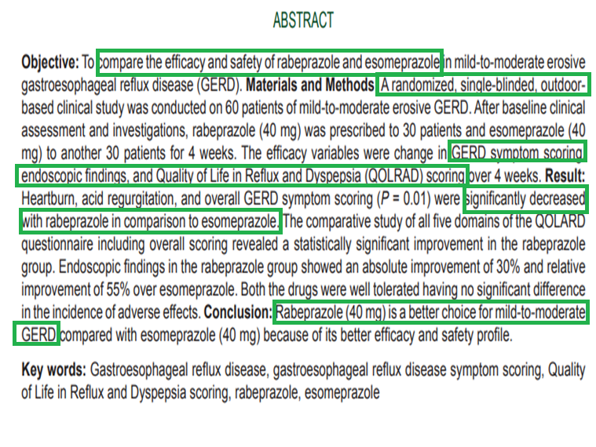
ABSTRACT
The author has mentioned the
Objective
Trial design
Methods
Results
Conclusion

Slide 4

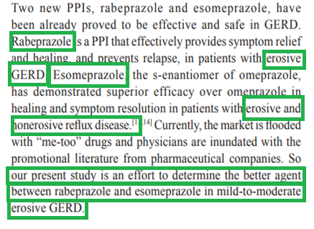
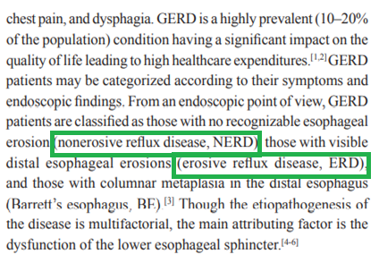
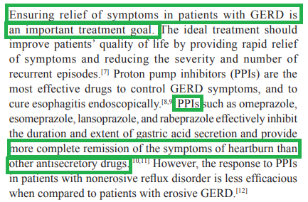
INTRODUCTION
Scientific background of the study
Why they selected these 2 drugs are not mentioned
Objective of the study

Slide 5
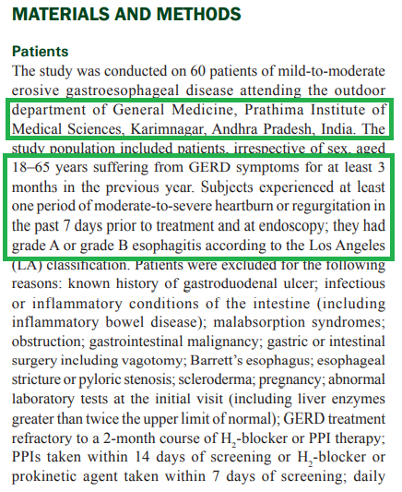
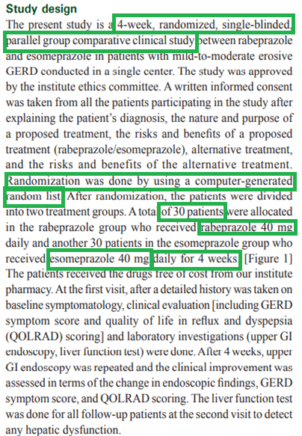

METHODOLOGY
Author has mentioned about
Trial design
Location
Eligibility criteria
Allocation sequence
Intervention to each group

Slide 6
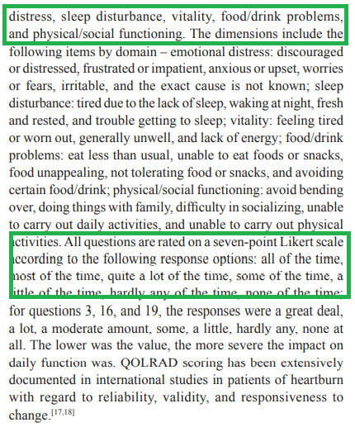
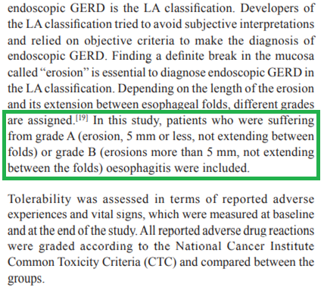
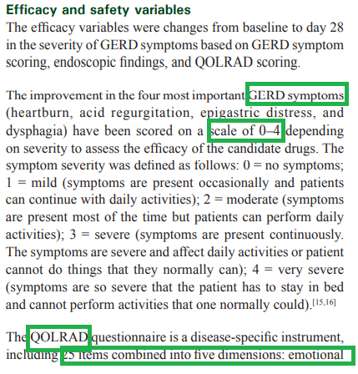
METHODOLOGY
Outcome assessment.

Slide 7
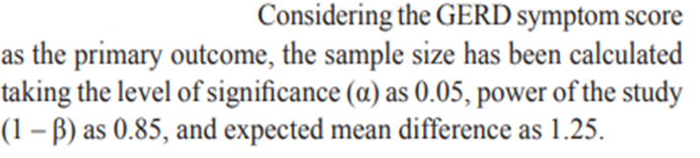
METHODOLOGY
Sample size calculation

Slide 8
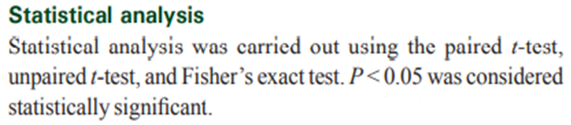
METHODOLOGY
Statistics used for data analysis.

Slide 9
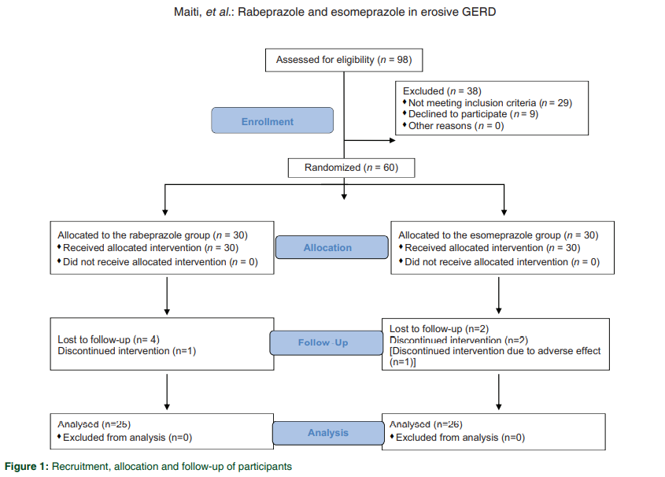

Slide 10
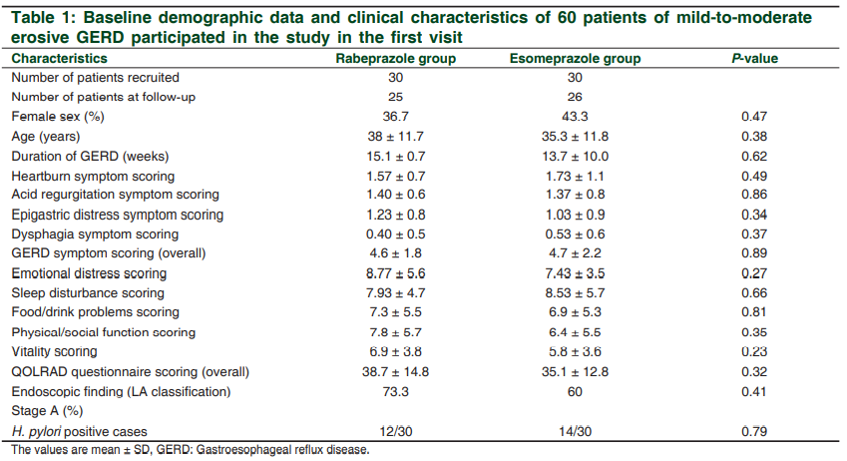
RESULTS
Baseline data
Numbers analysed
Outcomes are estimated with P value

Slide 11
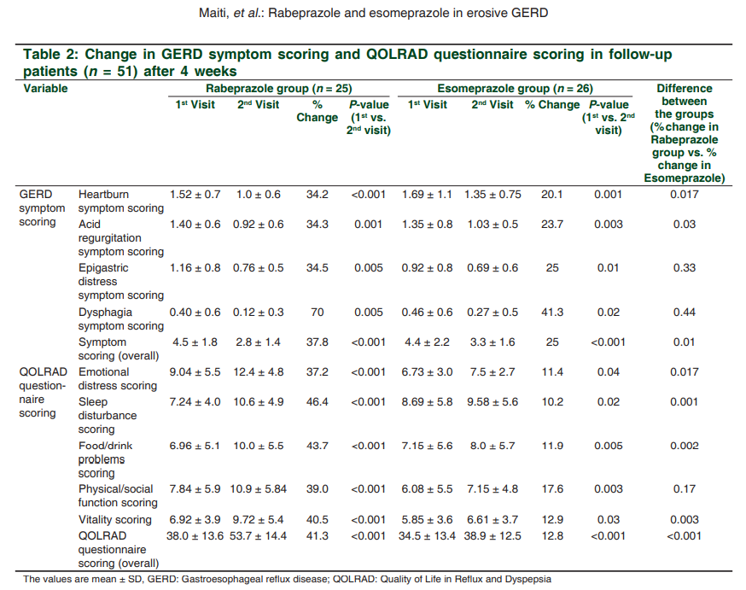
When is the second visit - not mentioned

Slide 12
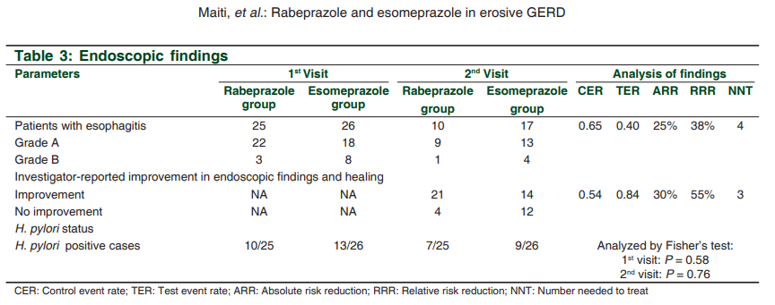
There is no control group

Slide 13

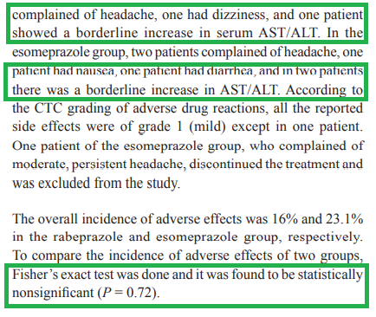
RESULTS
Author mentioned that adverse effect has been observed.

Slide 14

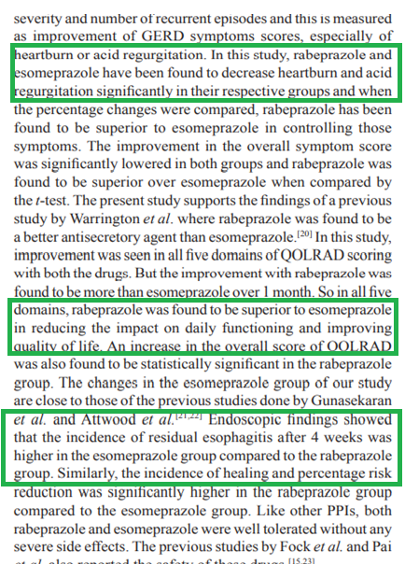
Interpretation of study results

Slide 15
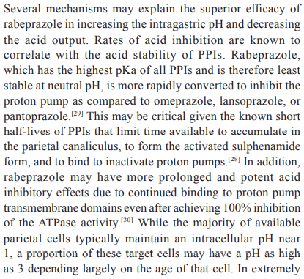
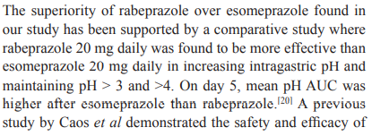
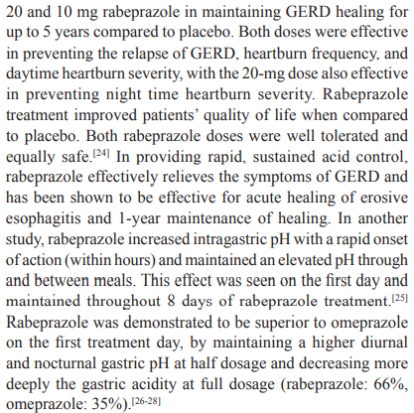
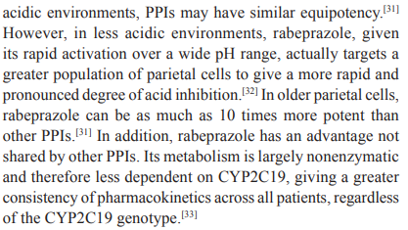
GENERALISABILITY / EXTERNAL VALIDITY

Slide 16
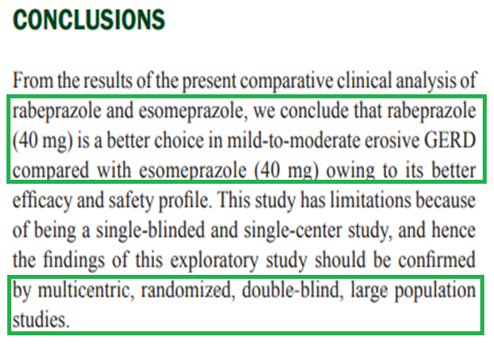
CONCLUSION
Author clearly stated the principal finding related to aim and objectives of the study.
Author has mentioned about study limitations

Slide 17
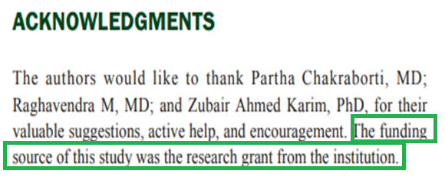
OTHERS
Vancouver referencing
Author has mentioned about funding
Registration number-not mentioned.

Slide 18
THANK YOU

